Slide 1
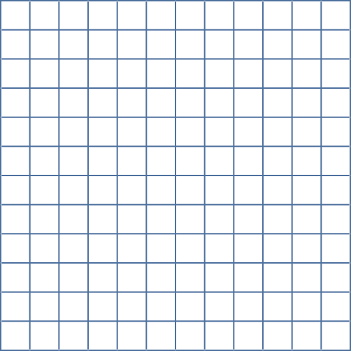



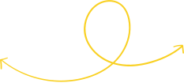




C.S.E.445.6
Group: 05
Face Recognition
Project Prompt: Design a face recognition system. Assemble a dataset comprising facial images of 10 individuals exhibiting various facial expressions. Demonstrate the performance of your method using this dataset.

Slide 2

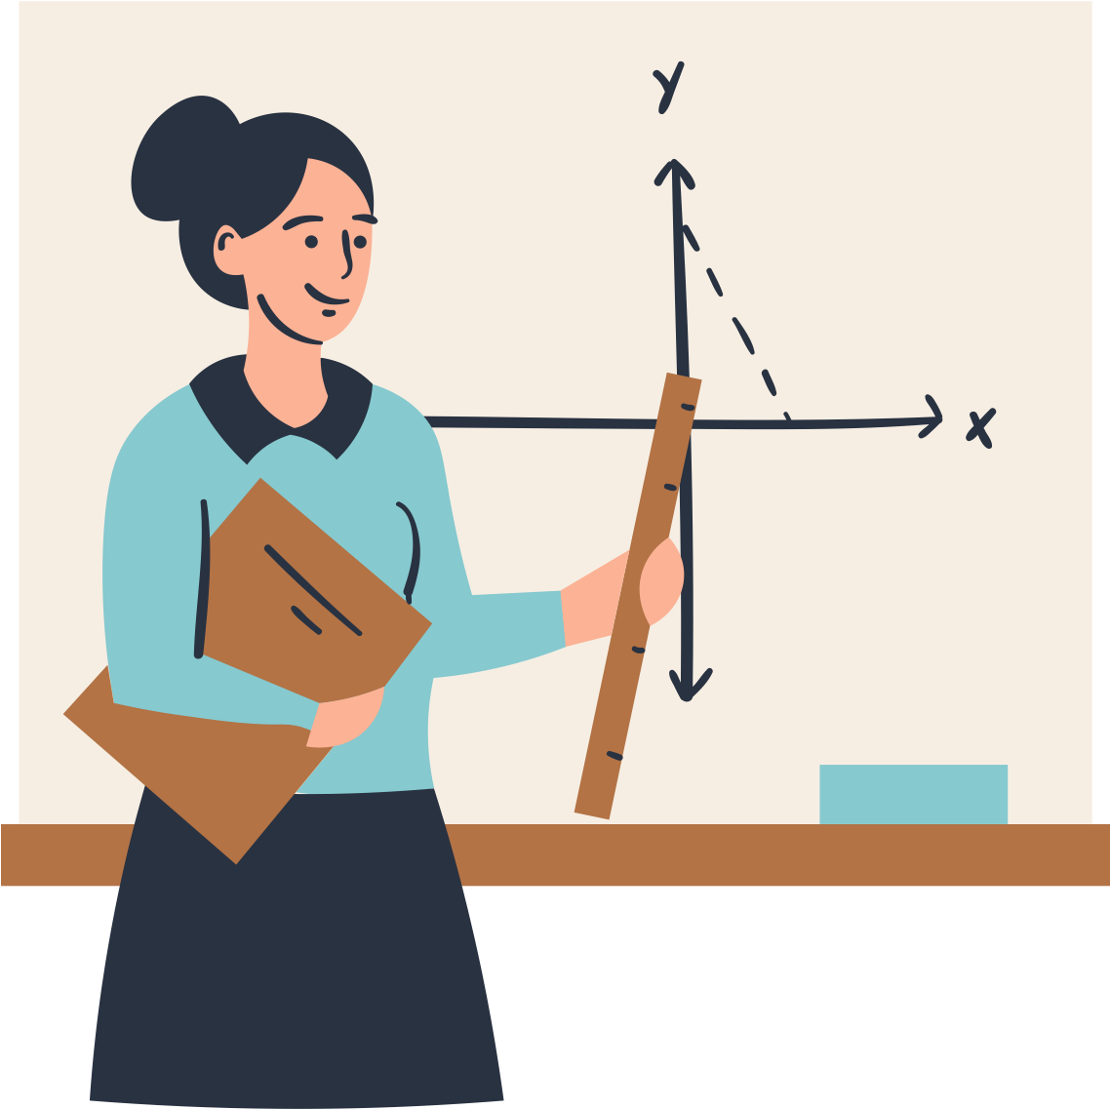


Table of Contents:
Datasets
AT&T
LFW
Models
SVM
KNN
RF
CNN (only for LFW)
Comparison between all Models

Slide 3
Datasets:
In our project we used two types of data sets to compare their performances at the last.
Feature | AT&T Data Set | LFW Data Set
Data Size | Small (400 Images) | Large(13,00+ Images)
Complexity | Simple (Uniform Background) | High (Varying Components)
Image Type | Grayscale (.pgm) | Color (.jpg)

Slide 4
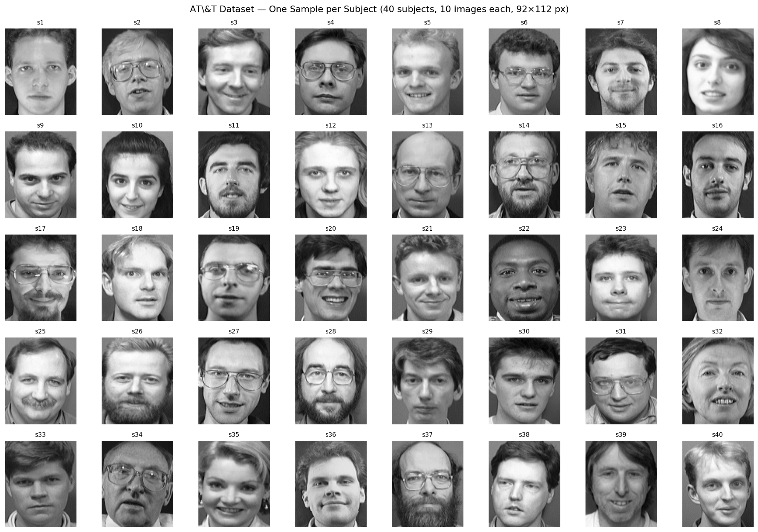
AT&T Data Set Sample Grid

Slide 5
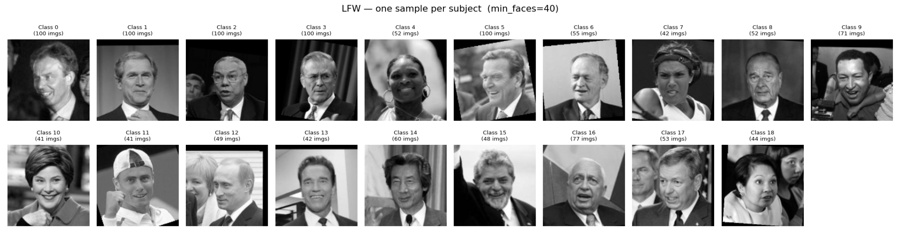
LFW Data Set Sample Grid

Slide 6
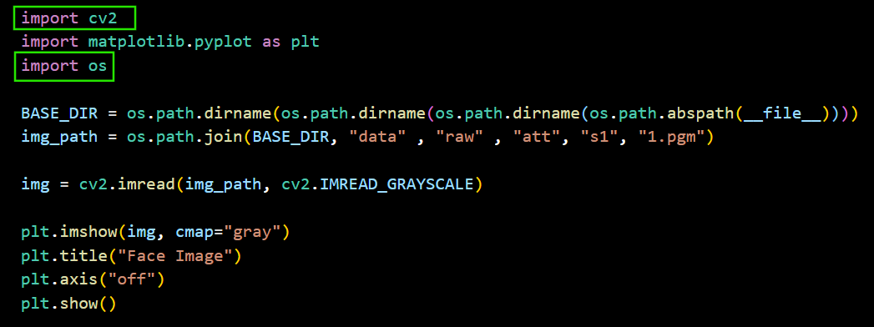
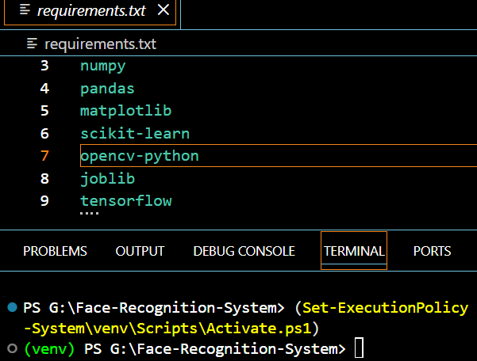
Code Utilities: Why checking_img.py is helpful:
Link: checking_img.py
Path Validation: Confirms the script can navigate the data/raw folder structure correctly.
Format Versatility: Proves the code can read different extensions (.pgm vs .jpg) using the same OpenCV logic.
Normalization Check: Ensures that color LFW images are correctly converted to grayscale via IMREAD_GRAYSCALE before processing.
Integrity Check: Acts as a "Sanity Test" to ensure images aren't corrupted before you start the heavy training phase.
Here we used open source computer vision library.
and, OS is helping us as navigator of image folders irrespective of windows/mac

Slide 7
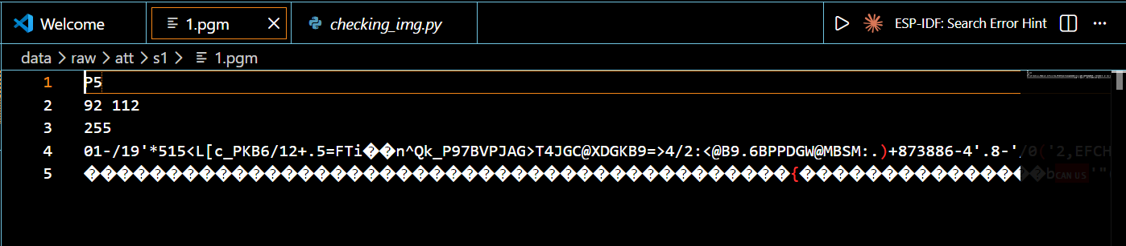
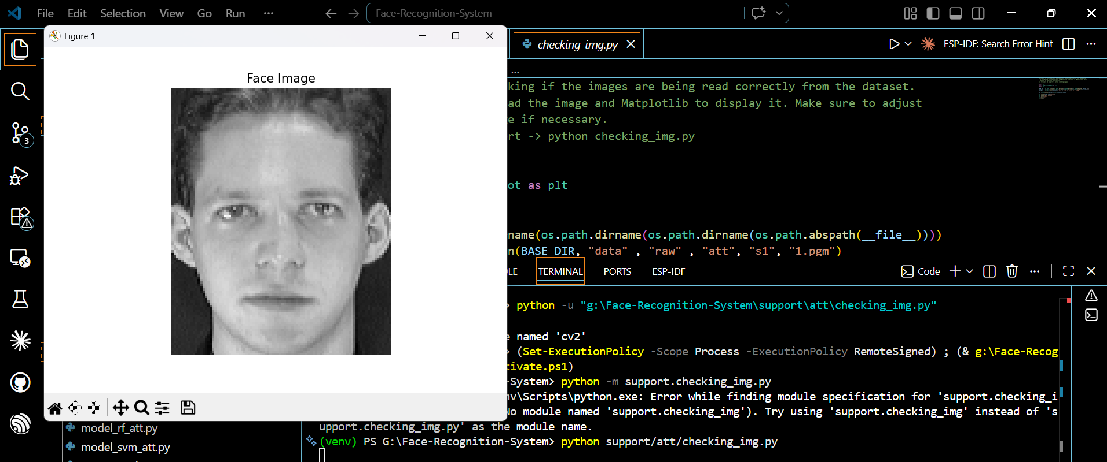
Before using checking_img.py
After using checking_img

Slide 8
Data Preprocessing (Preparing the Faces):
This is the "cleaning" phase to ensure the computer can read the faces efficiently.
Dataset Splitting (The Gold Standard):
AT&T: Uses an 80/20 Split (8 images per person for training, 2 for testing).
LFW: Uses a 60/20/20 Split (Train, Validation, and Test).
Stratification: We use "Stratified" splits to ensure every person in the dataset appears in both the training and testing sets.
Dimensionality Reduction (PCA / Eigenfaces):
The Problem: High-res images have too many "features" (pixels). For example, AT&T has 10,304 pixels per face.
The Solution: We use PCA (Principal Component Analysis) to compress those 10,000+ pixels down to just 100–150 "Eigenfaces."
Efficiency: This retains about 90–95% of the important facial info while making the model run 100x faster.
Normalization:
Whitening: We scale the data to ensure different lighting or contrast levels don't confuse the model.
Reshaping: Images are flattened into vectors for SVM, or kept as 2D grids for the CNN model.

Slide 9
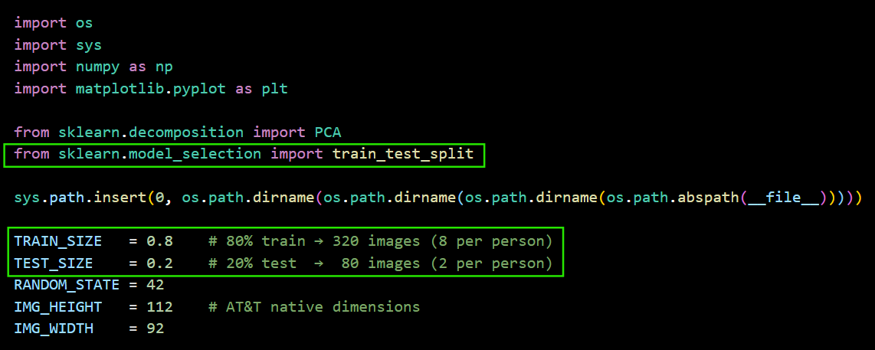
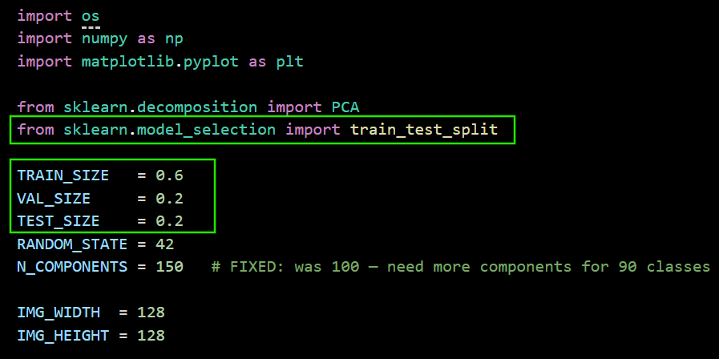
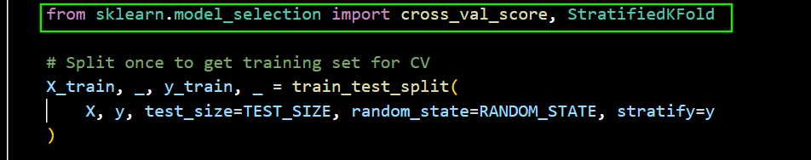
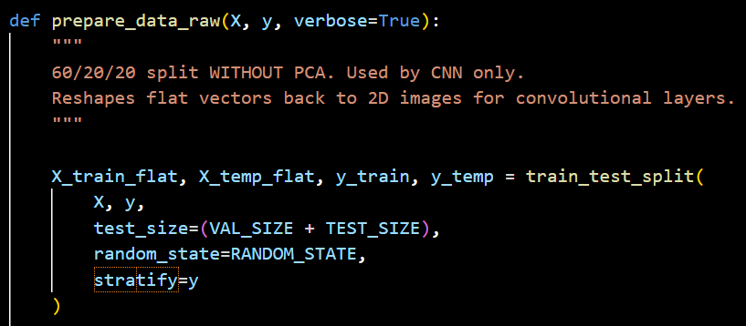
Link: preprocessing_att
Link: preprocessing_lfw.py

Slide 10
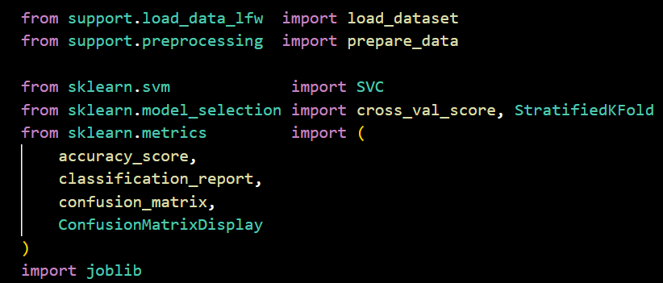
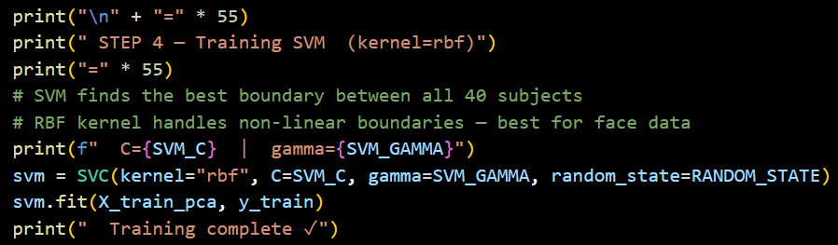

Modeling (Training the Classifier) :
SVM is a supervised learning algorithm that constructs an optimal separating hyperplane by maximizing the margin between classes in a high-dimensional feature space.
Our primary classifier. It finds the "best boundary" in mathematical space to separate Person A from Person B.
RBF Kernel: We use a non-linear (Radial Basis Function) kernel because facial data is too complex for a straight-line boundary. The parameters are C (regularization parameter) and Gamma (RBF kernel)
This is the "learning" phase where the computer learns to tell people apart.

Slide 11
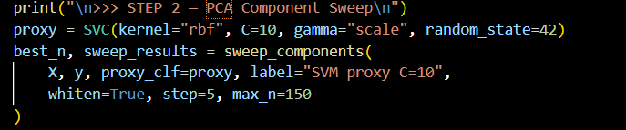
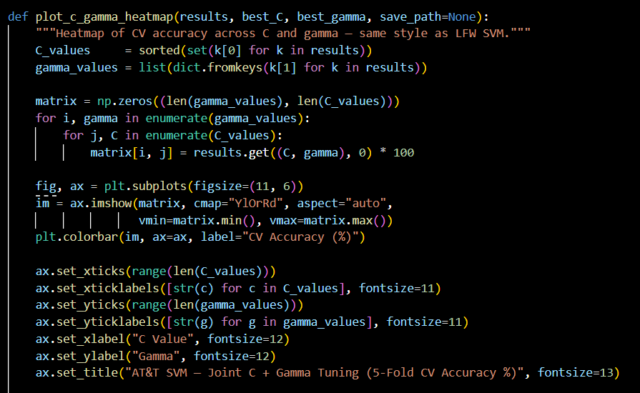
Modeling (Training the Classifier) Continued:
Hyperparameter Tuning:
We use a PCA Sweep to find the perfect number of components (e.g., is 100 eigenfaces enough, or do we need 150?).
C & Gamma: We tune these "knobs" in the SVM to balance accuracy vs. the ability to recognize new faces.
Link: svm_model.py

Slide 12
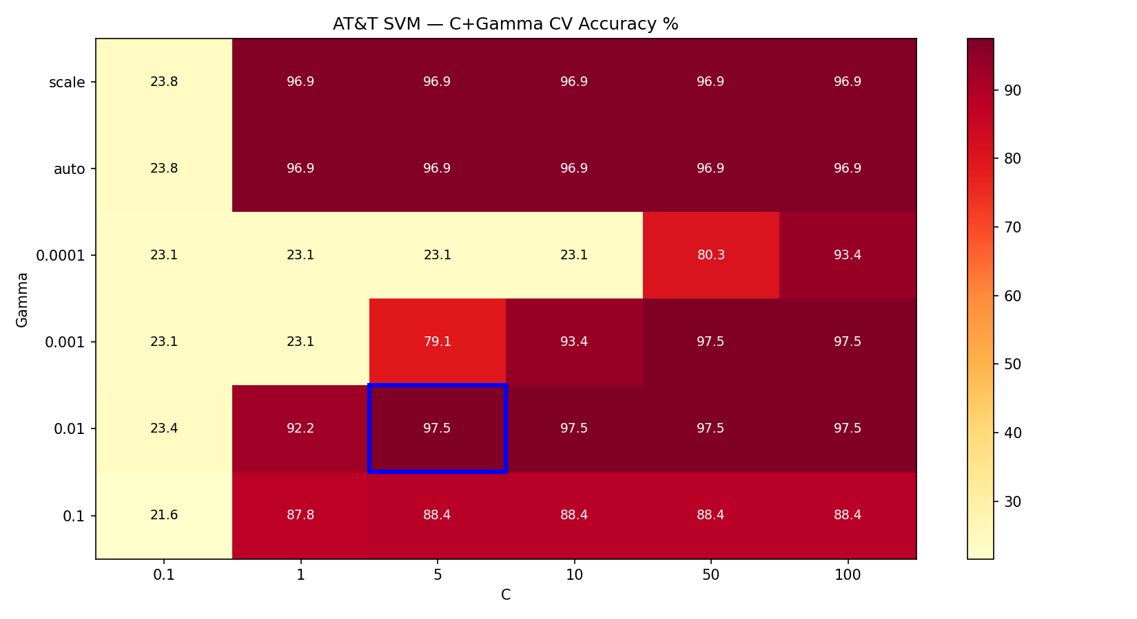
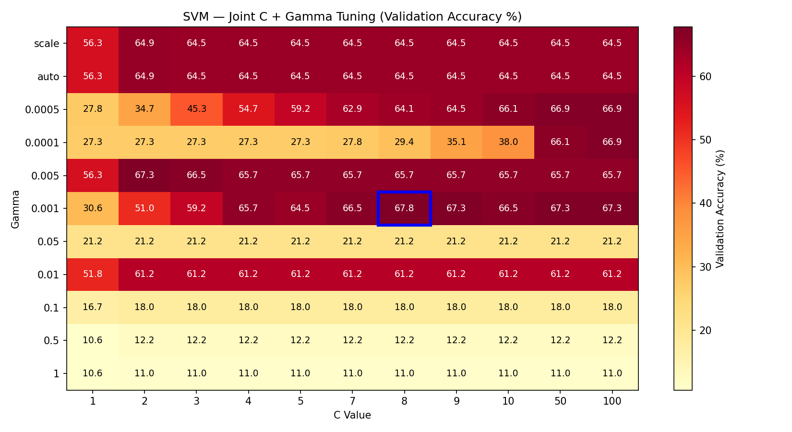
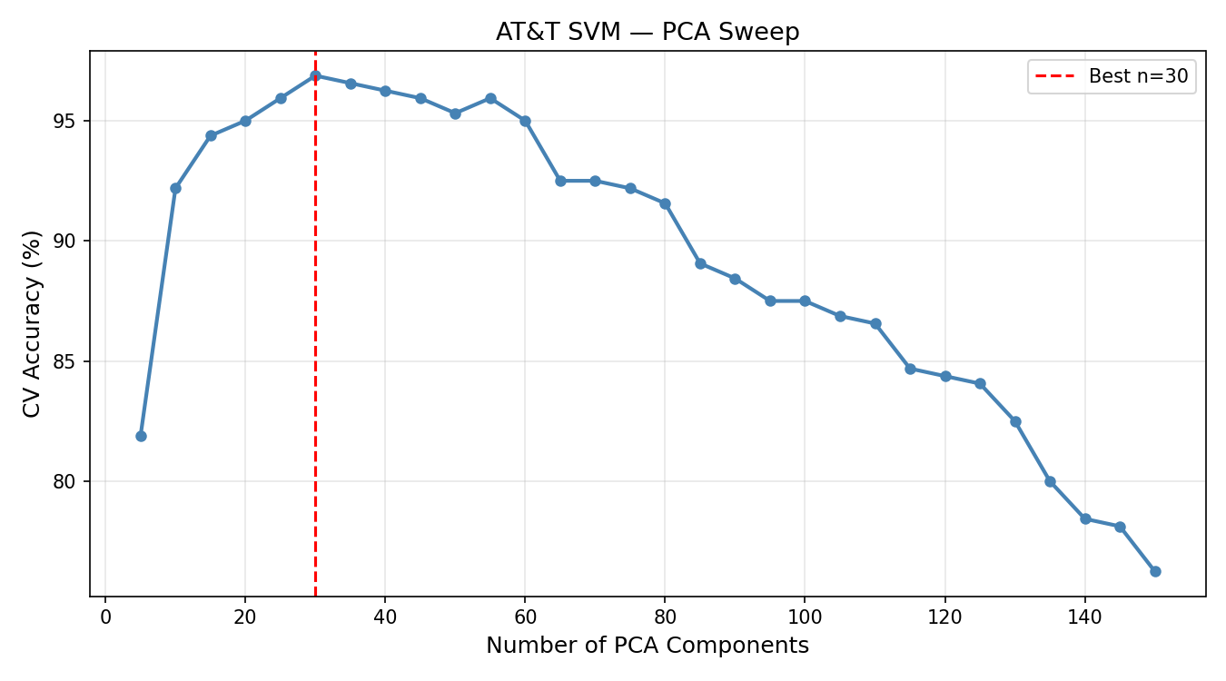
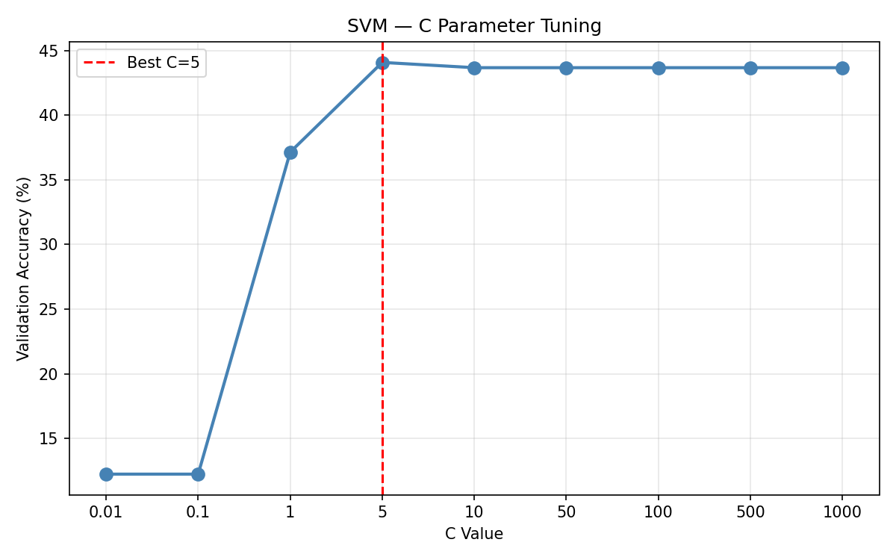
SVM ON AT&T
SVM ON LFW

Slide 13
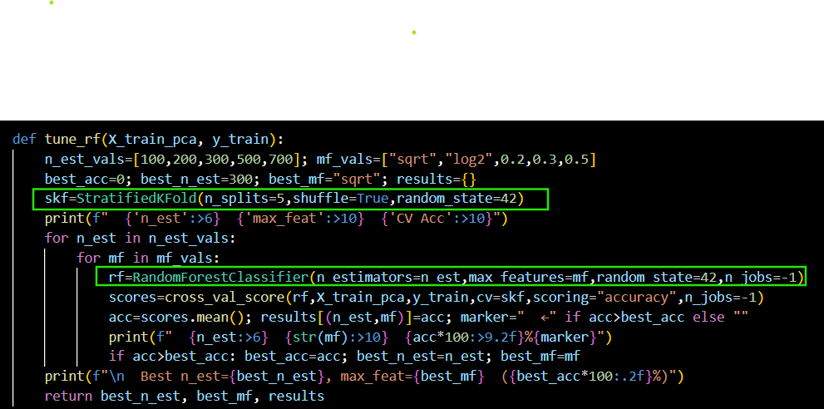
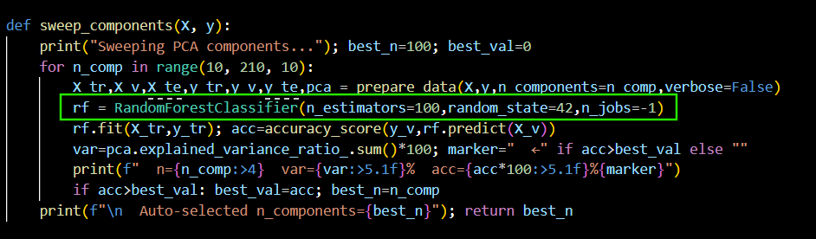
Modeling (Training the Classifier) Continued:
Random Forest: It uses a "majority vote" from hundreds of mini-decision trees to identify a face, making it very reliable.
Smart Selection: It's great at picking out which specific PCA features (like the eyes or nose) are most important for telling people apart.
Hyperparameters of this model is: n_estimators (the number of trees in forest) and max_features( the fraction of PCA components used)
Link: rf_att.py
Link: rf_lfw.py

Slide 14
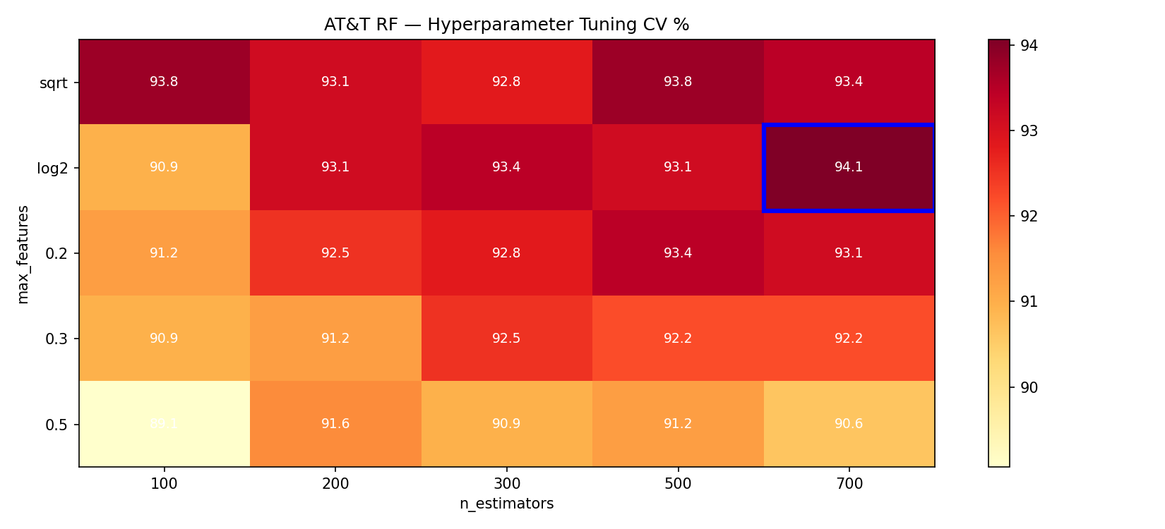
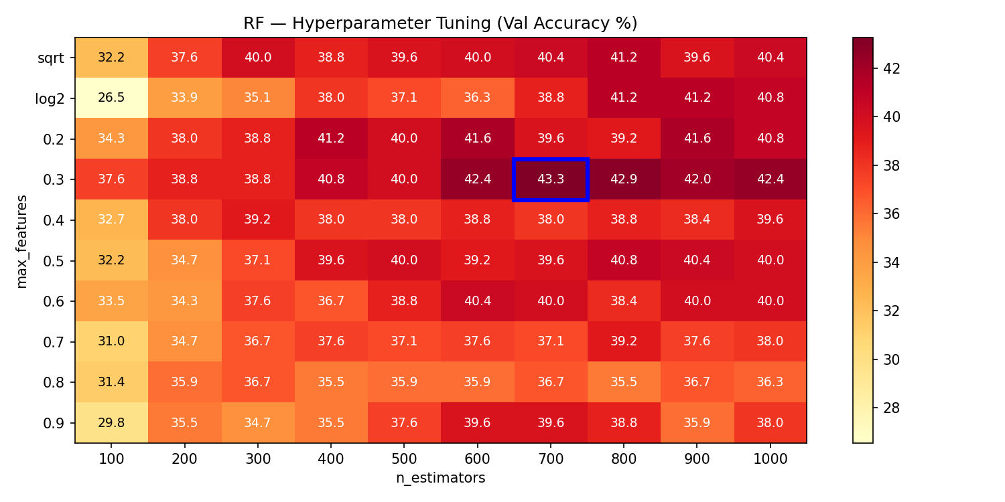
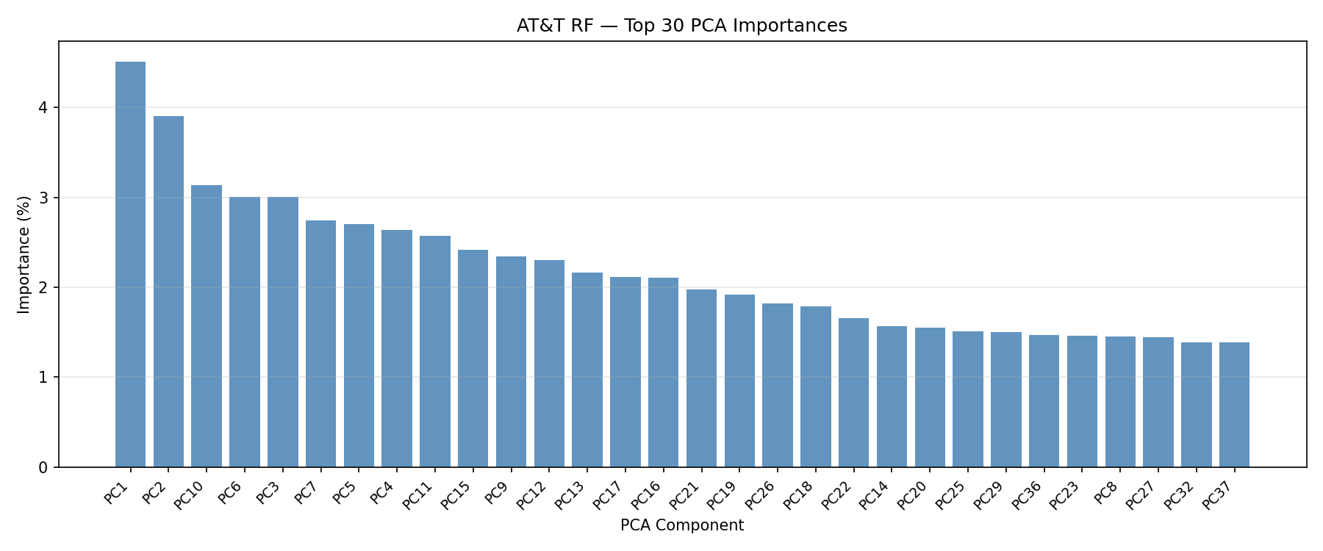
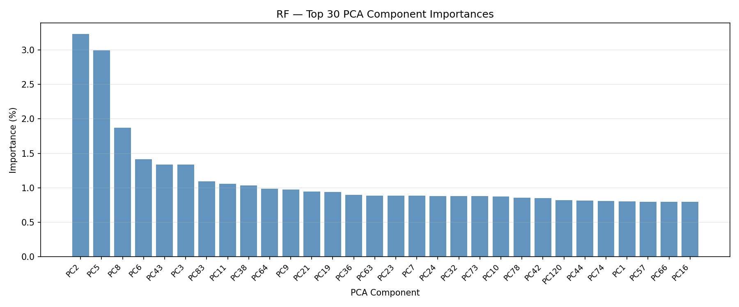
RF ON AT&T
RF ON LFW

Slide 15
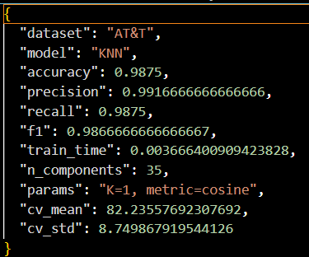
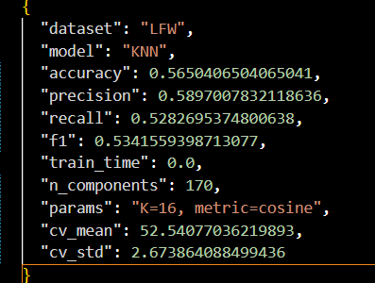
Modeling (Training the Classifier) Continued:
K-Nearest Neighbour:
The "Nearest Neighbor" Rule: It identifies a face by looking at the most similar images (neighbors) in the dataset and picking the most common result.
Simple & Fast: It doesn’t "learn" a complex boundary; it just memorizes the data, making it very easy to implement for small datasets like AT&T.
The metric we used is cosine similarity

Slide 16
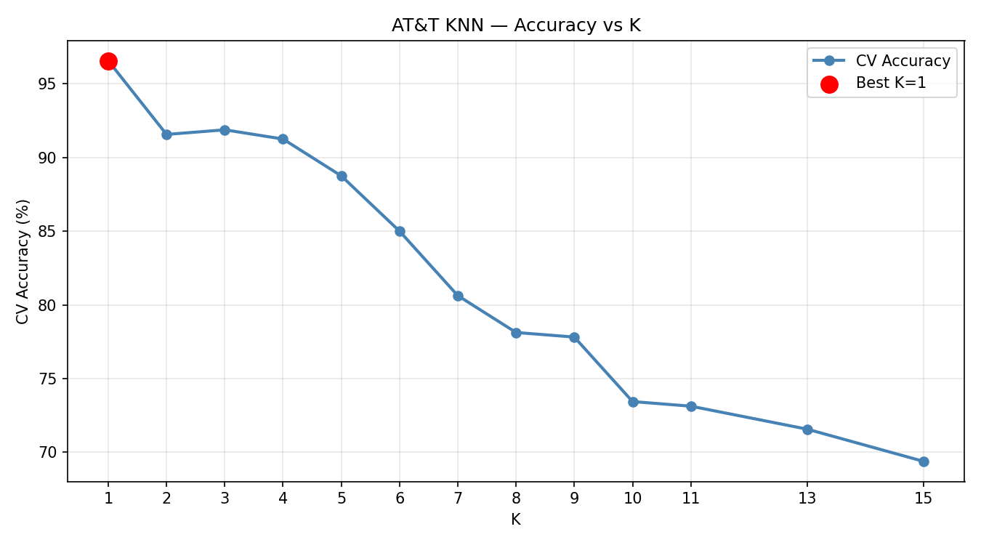
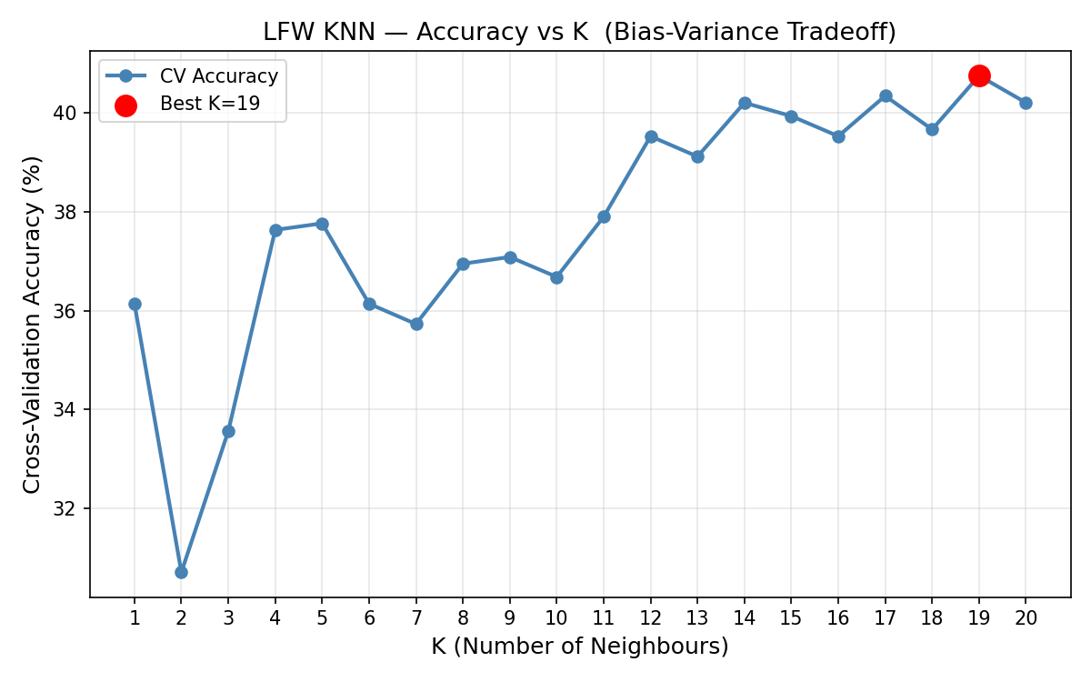
KNN on AT&T
KNN on LFW

Slide 17
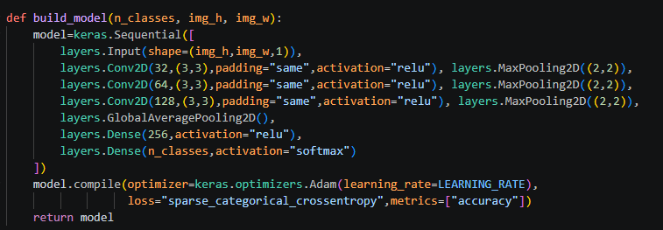
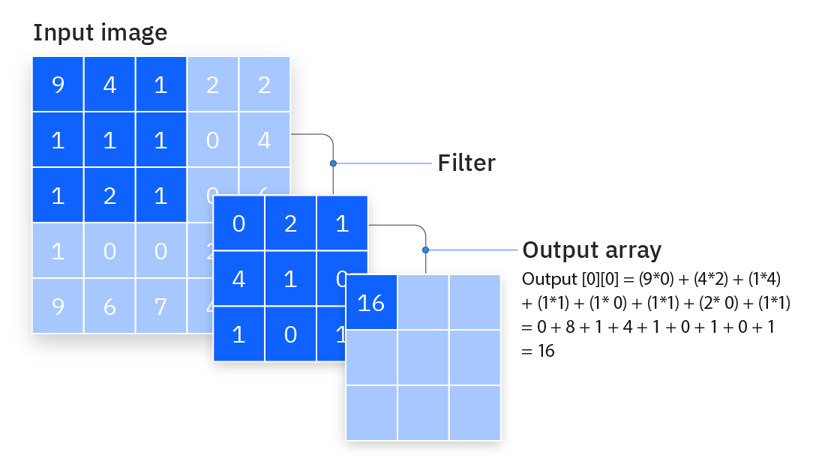
Modeling (Training the Classifier) Continued:
Convolutional Neural Network
Convolutional Blocks: The CNN has three convolutional blocks stacked in sequence. Each block applies a filter (32, 64, then 128 filters) that slides across the image looking for patterns — edges in block 1, facial features like eyes and nose in block 2, and higher-level face structure in block 3. After each block, Max Pooling halves the image size by keeping only the strongest signal in each 2×2 region, discarding the weaker ones. This progressively shrinks the spatial dimensions from 62×47 down to 7×5 while increasing the depth of features detected.

Slide 18
Modeling (Training the Classifier) Continued:
Convolutional Neural Network
GAP (Global Average Pooling)
Averages each feature map into one value.
Converts feature maps into a small vector.
Reduces overfitting.
Replaces flattening layer.
Softmax
Converts outputs into probabilities.
Values between 0 and 1.
All outputs sum to 1.
Highest value = predicted class.
Convolution Operation
Slides a small filter (kernel) over the image.
Multiplies filter values with image pixels and adds them up.
Produces a new “feature map” showing patterns.
Helps detect features like edges, textures, and shapes.
Max Pooling
Keeps the strongest value in each region.
Reduces image size.
Removes noise/less important info.
Keeps key features.

Slide 19
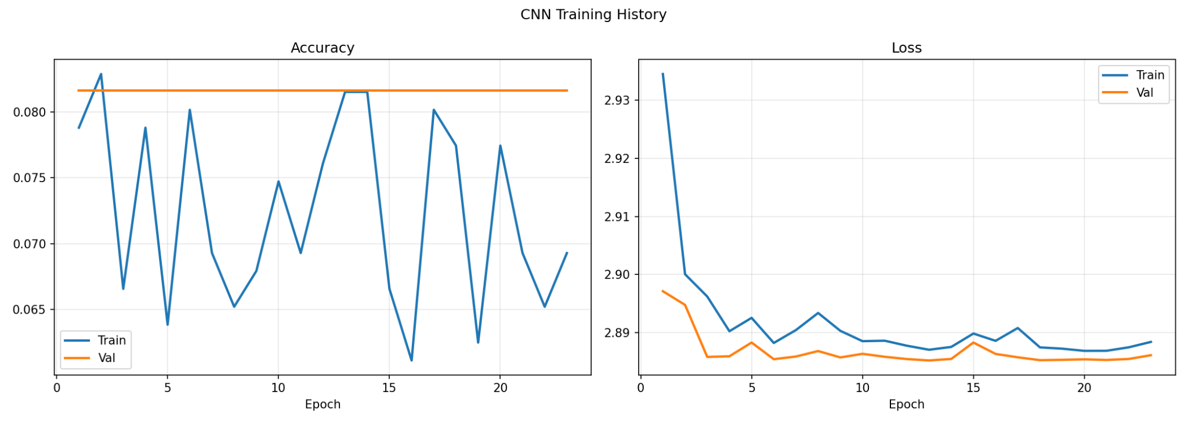
CNN on LFW

Slide 20
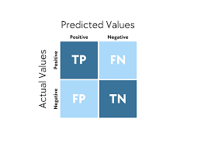
Modeling (Training the Classifier)
Model Evaluation: Confusion Matrix Analysis" SVM · KNN · CNN on AT&T & LFW Datasets
We will compare the confusion matrix of SVM,KNN & CNN for AT&T and LFW
A confusion matrix shows how many times the model correctly identified a person (diagonal) vs. mistook one person for another (off-diagonal)
Each row represents the actual person; each column represents who the model predicted
A perfect model has all values on the diagonal and zeros everywhere else
For face recognition, off-diagonal errors mean the model confused one person's face with someone else's — which is the most critical failure

Slide 21
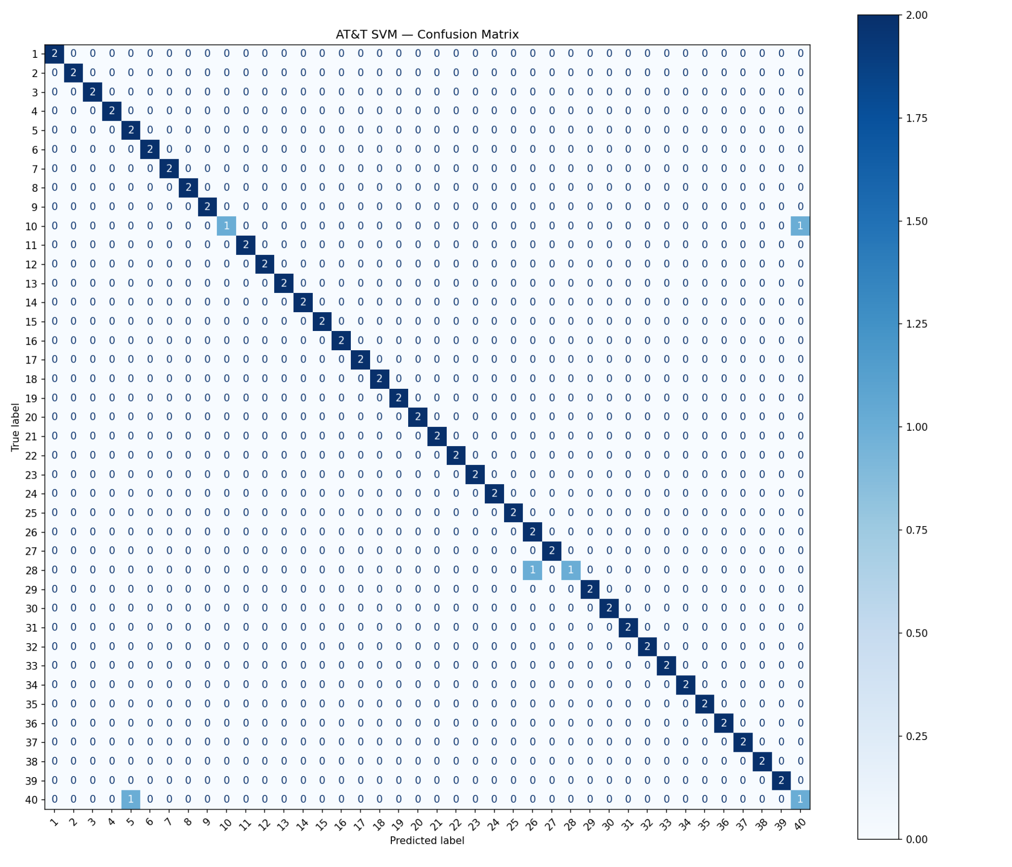
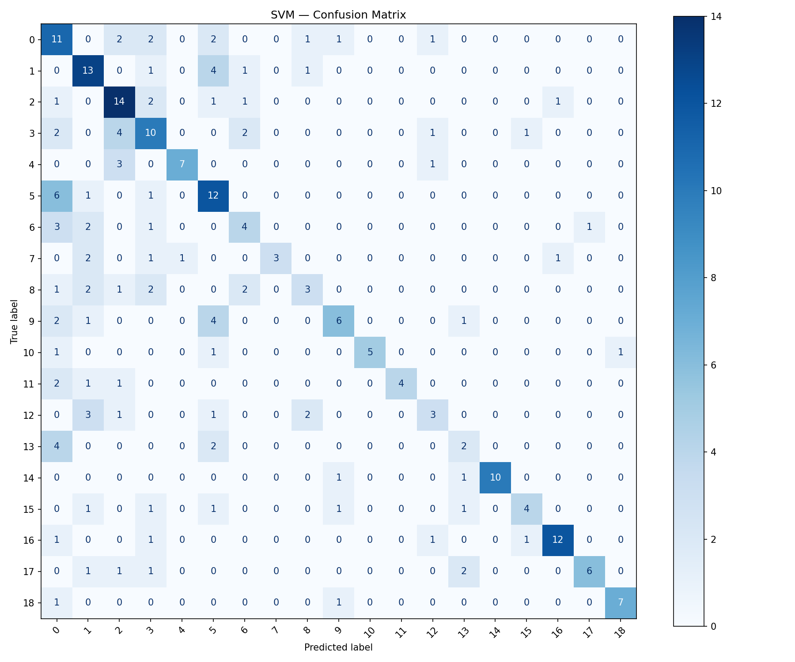
SVM ON AT&T
SVM ON LFW

Slide 22
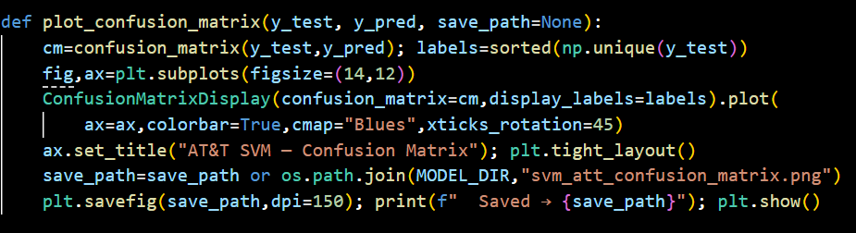
SVM EVALUATIONS
AT&T SVM (96.25%)
96.25% accuracy — only 3 out of 80 test faces misclassified; confusion matrix is nearly all diagonal (C=5, gamma=0.01, PCA=30 components)
AT&T is a controlled dataset (same lighting, background, only expressions vary) — ideal conditions for SVM's RBF kernel to draw clean boundaries between 40 subjects
Best hyperparameters found by grid search across C and gamma values — the C-Gamma heatmap in the code shows why C=5, gamma=0.01 won over other combinations
LFW SVM (55.28%)
Result: 55.28% accuracy — best LFW model by a large margin (15+ percentage points above KNN and RF). CV mean 57.29% ±1.76% nearly matches test accuracy — the model is stable and not overfitting, it has simply hit the ceiling of what PCA+SVM can do with 36–52 training images per person under real-world variation
The confusion matrix has a visible but imperfect diagonal — some subjects are consistently confused with each other, likely those with similar hairstyles or skin tone in PCA space
Code link

Slide 23
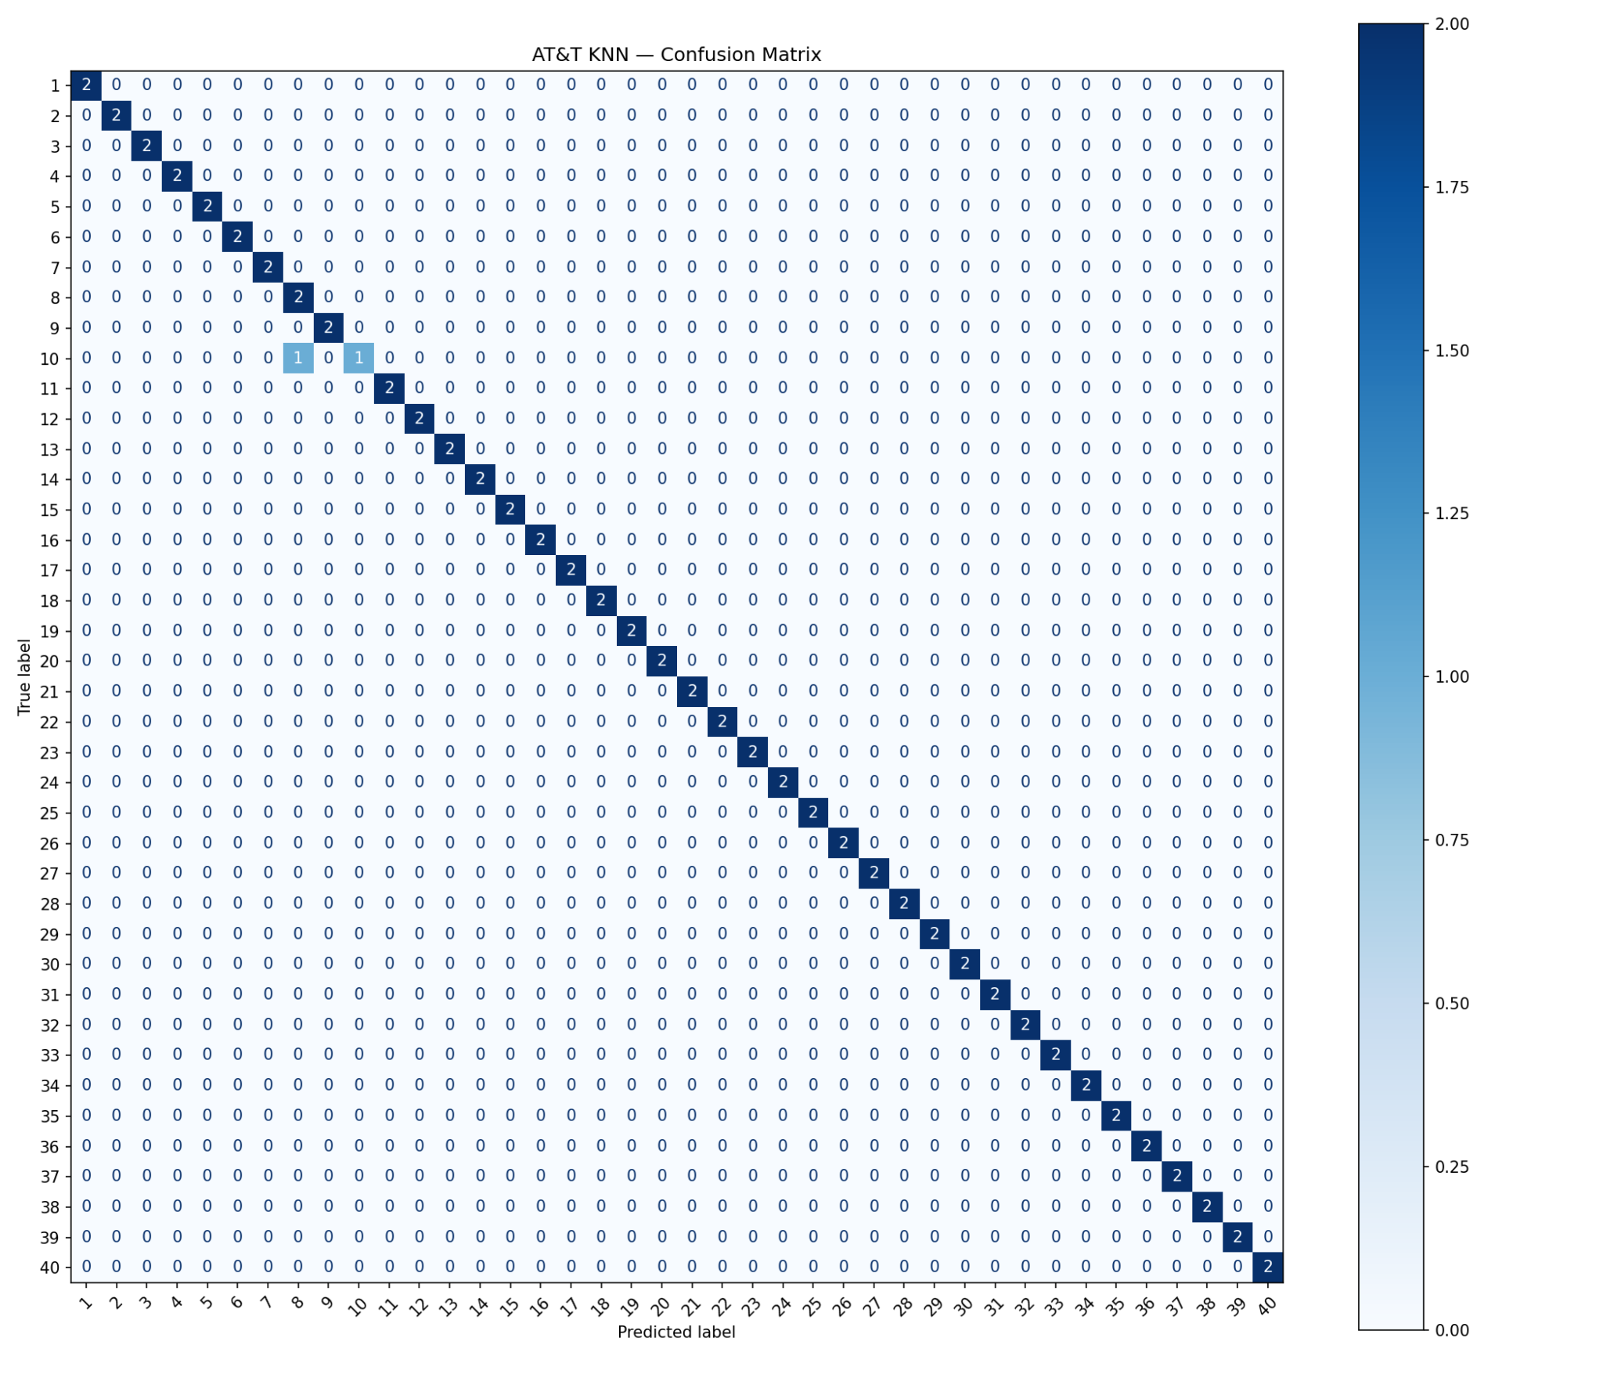
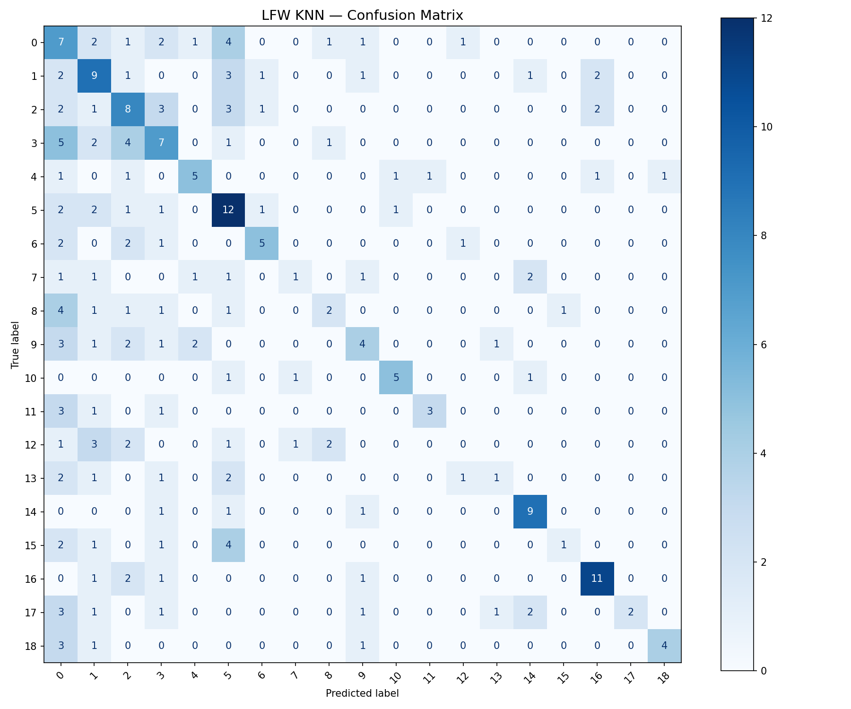
KNN on AT&T
KNN on LFW

Slide 24
KNN EVALUATIONS
AT&T KNN (98.75%)
Result: 98.75% accuracy — highest on AT&T, only 1 face misclassified out of 80
BUT: cross-validation mean was only 82.24% with high std (±8.75%) — this means the model is sensitive to which images end up in the test set (overfitting risk on small data)
The confusion matrix shows one single off-diagonal entry — almost perfect
LFW KNN (39.02%)
Result: 39.02% accuracy — optimal K jumped from 1 (AT&T) to 19 (LFW), meaning the model needs to consult 19 neighbours just to average out the noise. CV mean 37.78% ±2.48% closely matches test accuracy — no overfitting, just a hard problem
The confusion matrix is more diffuse than SVM with errors scattered across many subjects — cosine distance in 160-dimensional PCA space struggles to reliably separate subjects whose photos vary widely in lighting and pose

Slide 25
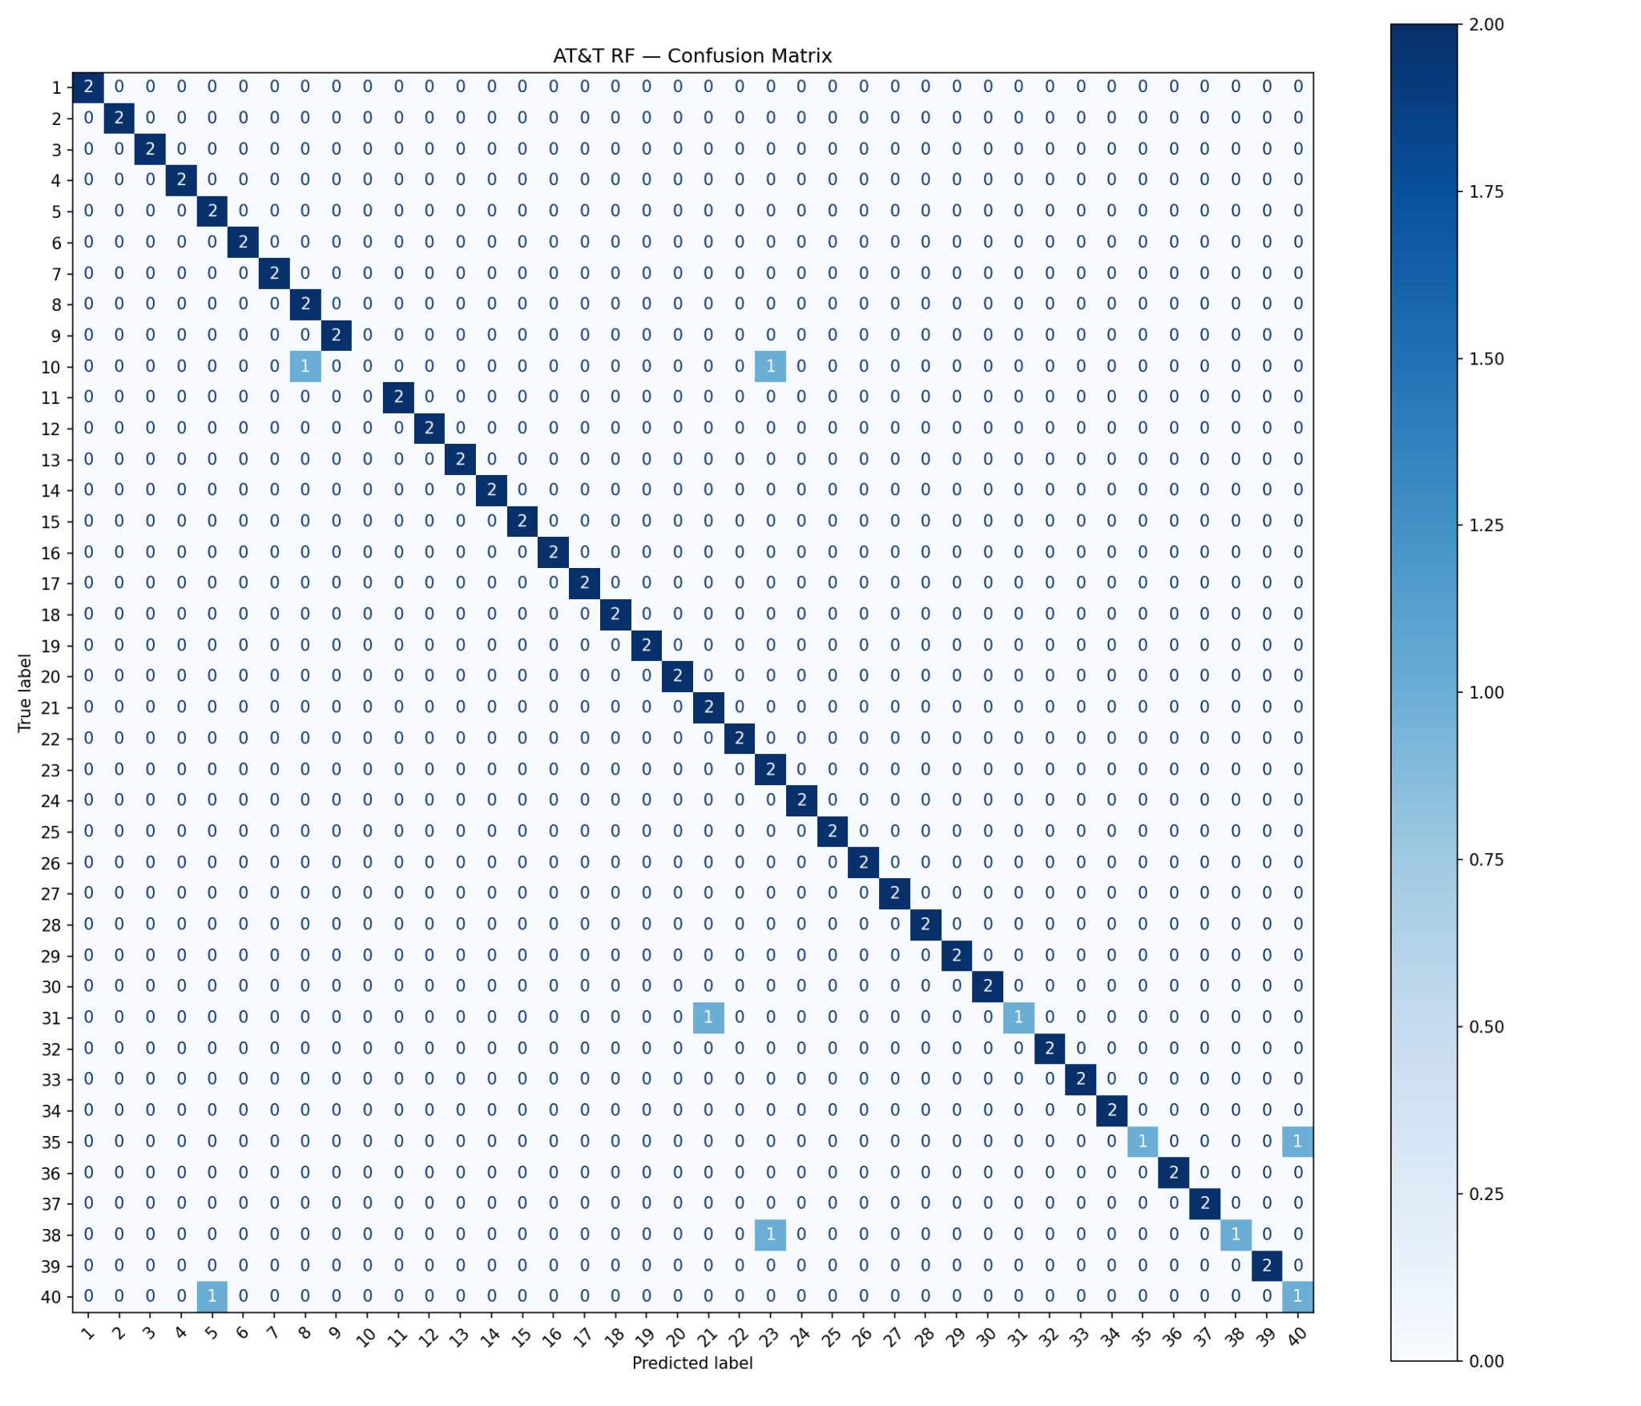
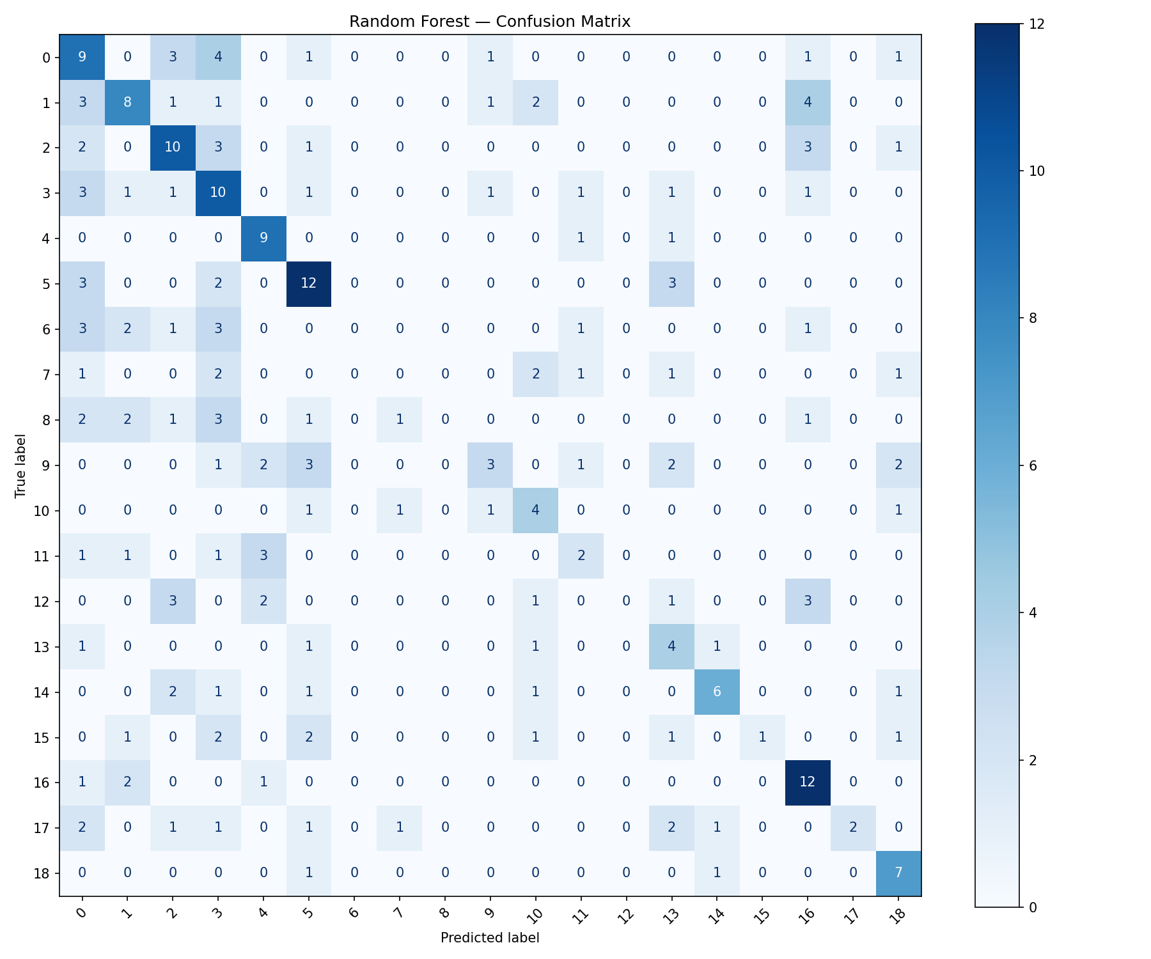
RF ON AT&T
RF ON LFW

Slide 26
RF EVALUATIONS
AT&T RF (92.50%)
Result: 92.50% accuracy — 6 faces misclassified out of 80, the weakest AT&T model. CV mean 94.06% ±1.82% is stable and slightly above test accuracy — no overfitting concern, just a genuine performance ceiling
Feature importance shows classification concentrates almost entirely in PC1–PC10 out of 70 components — the other 60 components contribute noise. 700 trees with log2 feature subsampling was needed to get the best diversity out of only 320 training images
LFW RF (40.24%)
Result: 40.24% accuracy — effectively tied with KNN despite using a completely different mechanism. CV mean 41.08% ±3.86% is the highest std of the three classical LFW models — RF is more sensitive to which training fold it gets, consistent with the randomness of its tree-building process
Feature importances are more spread out than AT&T, meaning the model needed components across a wider range to discriminate 19 real-world subjects — confirming that real-world faces require broader feature coverage than controlled ones

Slide 27
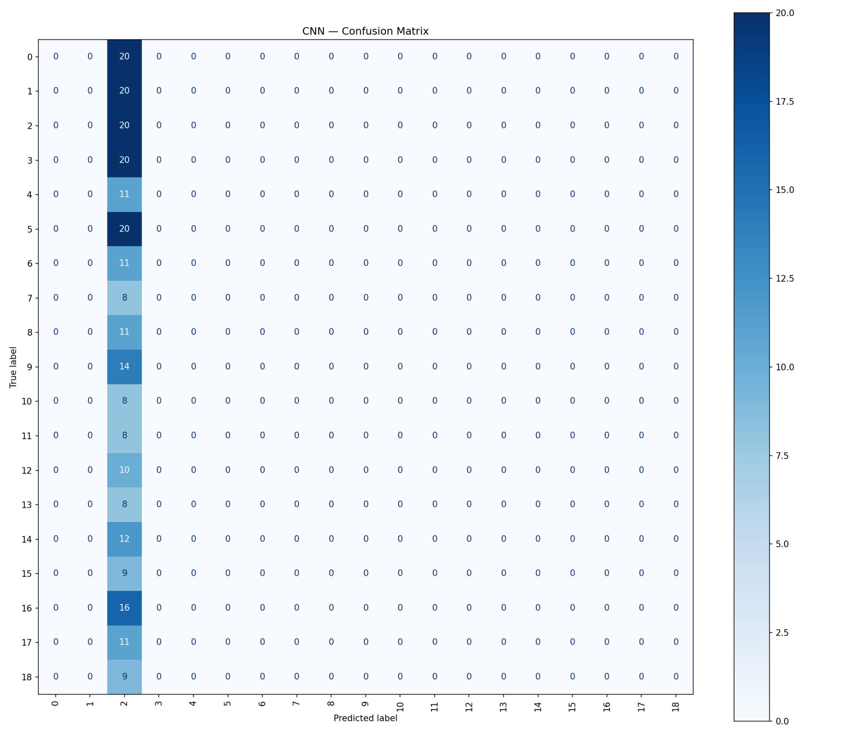
CNN on LFW

Slide 28
CNN EVALUATION
LFW CNN (8.13%)
Result: 8.13% accuracy — barely above the 5.26% random chance baseline for 19 classes. Precision was 0.43% meaning nearly every prediction was wrong even when the model committed to a class — it predicted one or two dominant subjects for almost all 246 test images
Training and validation loss were identical from epoch 1, confirming the model never learned anything at all. No amount of architectural tuning fixes this — the root cause is 36–52 training images per person against a minimum requirement of roughly 1,000+

Slide 29
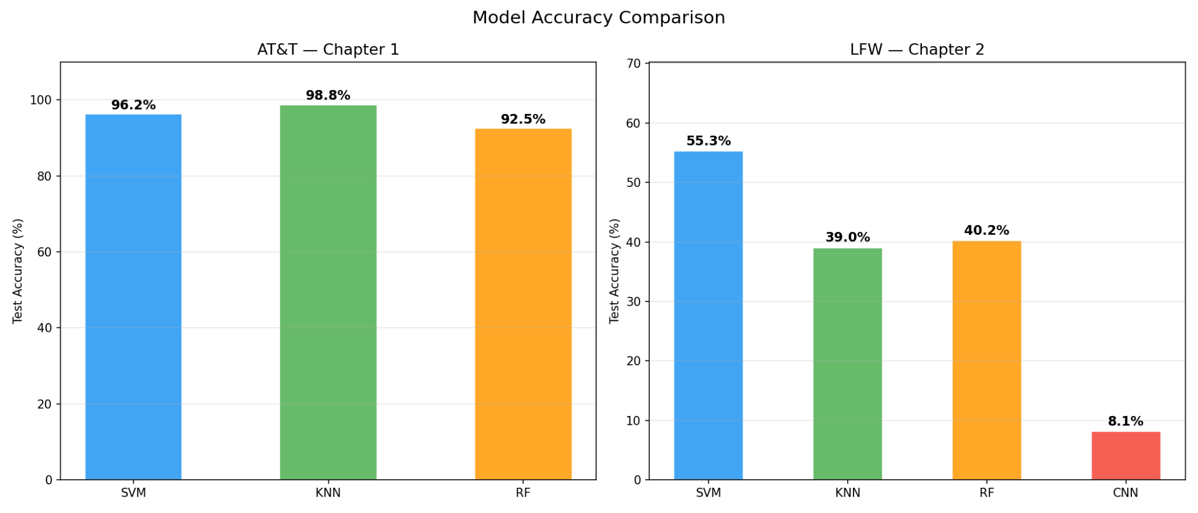
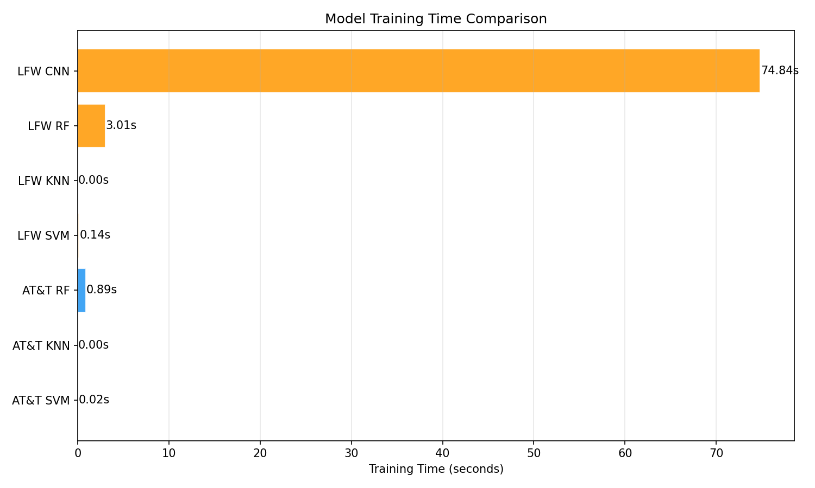
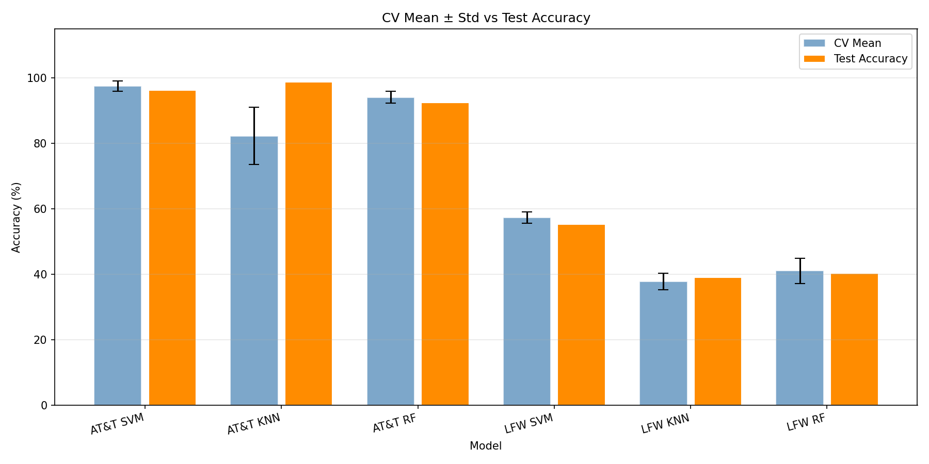
Comparison between all 7 models

Slide 30
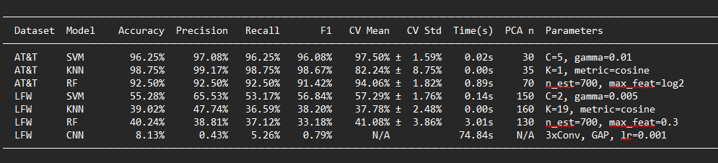
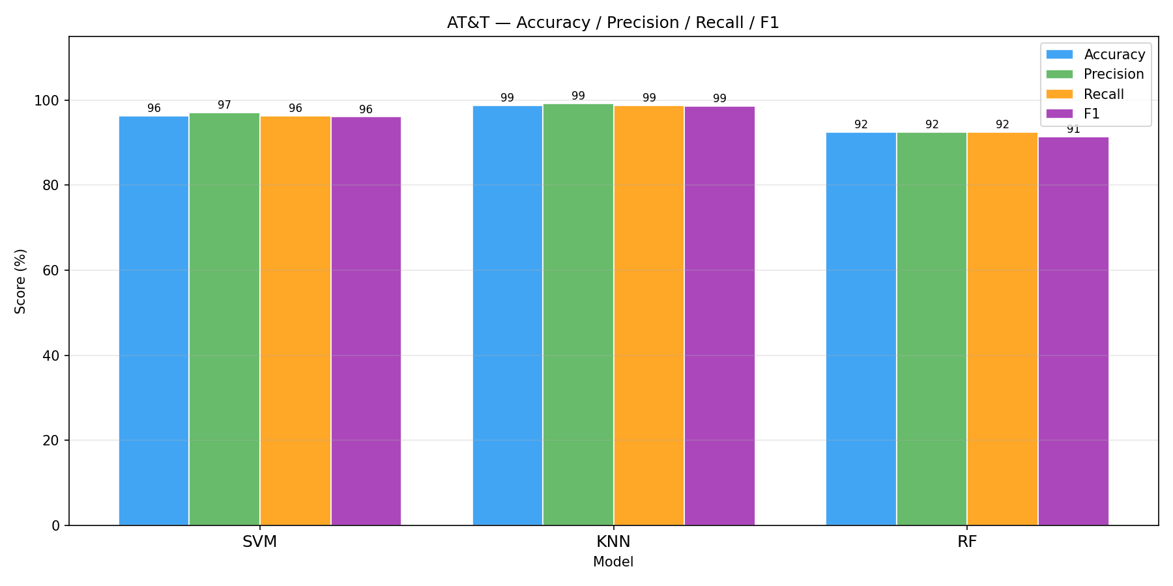
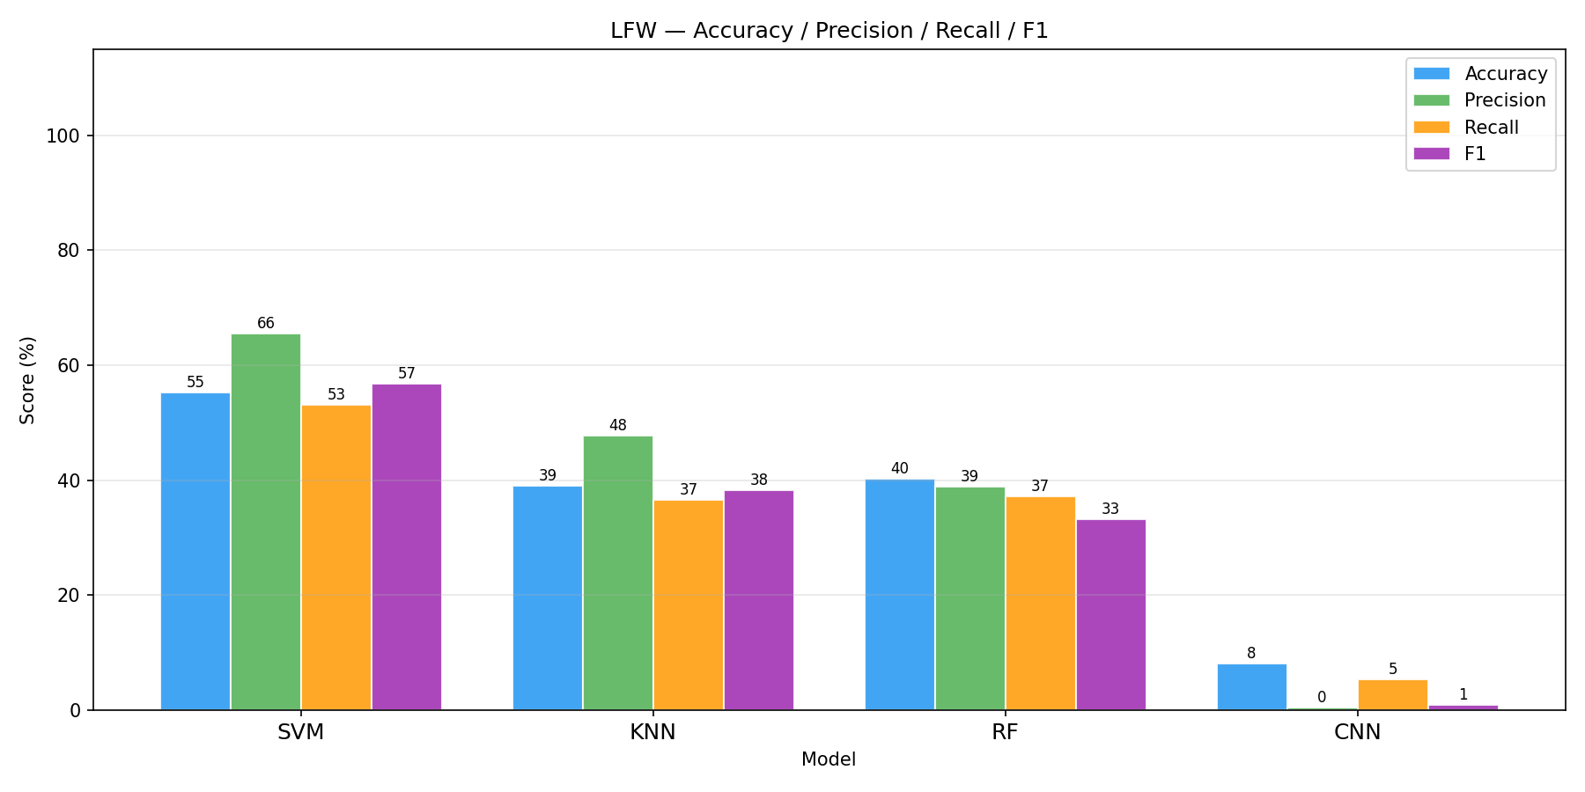
Comparison between all 7 models

Slide 31
Comparison Summary:
SVM wins both datasets — 96.25% AT&T, 55.28% LFW — lowest CV std (±1.76% on LFW), fastest training (0.13s), most stable generalisation
KNN is fastest (0s train) but most fragile — best single result (98.75% AT&T, K=1) but worst classical on LFW (39.02%, K=19) — biggest drop of any model (−59.73pp)
RF is consistent but never dominant — 3rd on both datasets, highest CV std (±3.86% LFW), needed 700 trees, feature importance shows only top 10 PCA components matter
CNN failed completely — 8.13% LFW (barely above 5.26% random chance), train and val loss identical from epoch 1 — root cause is data starvation (36–52 train images vs 1,000+ needed)
AT&T is easy, LFW is hard — controlled vs real-world: every model drops 40–60pp between datasets, gap is not a bug but the expected cost of unconstrained face recognition
Classical methods hit a ceiling at ~40% on LFW — all three models converge to the same floor regardless of algorithm choice — bottleneck is data, not model
To break through the ceiling — transfer learning (FaceNet, ArcFace) trained on millions of images is the only realistic path forward

Slide 32
Deep Learning: CNN (Convolutional Neural Network)
3 Major Reasons Why It Failed:
Insufficient Data Per Person: Many subjects in LFW have only one image, making it impossible for the model to "learn" their features and then "test" them later.
Extreme Variation: Unlike the controlled AT&T set, LFW includes variations in lighting, pose, and background that simple linear models (SVM/KNN) struggle to filter out.
Data Leakage/Mismatch: If the training set doesn't have enough variety for each class, the model cannot generalize to the test images.

Slide 33
KEY FINDINGS
SVM is the best classical model — ranked first on both datasets, most stable CV, best accuracy-to-time ratio
The controlled-to-real-world gap is large — every model dropped 40–60pp from AT&T to LFW, this is the cost of real-world variation not a tuning problem
KNN is unreliable under variation — best single result (98.75%) but worst classical on LFW (39.02%), K jumping from 1 to 19 measures exactly how much the nearest-neighbour assumption breaks down
Only ~10 Eigenfaces actually matter — RF importance showed higher-order components add noise not signal, on both datasets regardless of how many were available
CNN needs ~100x more data — 36–52 training images vs 1,000+ required, confirmed by identical train/val loss from epoch 1
Stability matters as much as accuracy — KNN had the highest peak (98.75%) but worst CV std (±8.75%), SVM had lower peak but far better stability (±1.59%)
~40% is the classical ceiling on LFW — all three classical models converged there regardless of algorithm, only transfer learning can break through

Slide 34
Thank you for listening to our presentation!
Any Questions?

Slide 35



LET'S RECALL AND ANALYZE!
y
12
10
Do you still remember how to fill in the table of values based on a given graph?
Complete the table of values below.
8
6
4
2
x
y
x
2
4
6
8
10
12

Slide 36
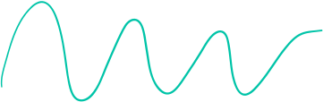
LEARNING OUTCOMES
By the end of the lesson, you'll be able to:
Express relations and functions in tables and graphs.
Differentiate between a relation and a function.
Use a vertical test.

Slide 37






WHAT ARE RELATIONS?
A relation is a set of ordered pairs that represent a relationship.
Example:
Names and their age are a set of ordered pairs that we could put into a table.
Name | Alex | Jude | Arlo | Casey
Age | 9 | 12 | 11 | 11

Slide 38





WHAT IS A FUNCTION?
A function is a special type of relation where each input only has one output.
Functions are a way of connecting inp﻿ut values to their corresponding output values.
The relation is a function if, for every x-value, there is exactly one y-value.

Slide 39



WHAT IS A FUNCTION?
Functions are a way of connecting inp﻿ut values to their corresponding output values.
Example:
Ordering a coffee for $5
Pay $5, and you get 1 coffee.
Pay $10, and you'll get 2 coffees, and so on.
The input affects the output in a predictable way.

Slide 40

GRAPHING A FUNCTION USING THE TABLE OF VALUES
Step 2:
Given the equation y = 2x.
y
Plot the points.
4
Step 1:
3
Construct the table of values.
2
Do this by substituting values of x to y=2x.
1
x
-1
0
1
2
x | -1 | 0 | 1 | 2
y | -2 | 0 | 2 | 4
-1
-2
Notice that for every value of x, there is only one value of y.

Slide 41
GRAPHING A FUNCTION USING THE TABLE OF VALUES
Step 2:
Given the equation y = 2x.
y
Plot the points.
4
Step 1:
3
Construct the table of values.
2
Do this by substituting values of x to y=2x.
1
x
-1
0
1
2
x | -1 | 0 | 1 | 2
y | -2 | 0 | 2 | 4
-1
-2
Notice that for every value of x, there is only one value of y.

Slide 42


TRY THIS!
Is this relation a function?
x | -6 | -3 | 2 | 7 | 9 | 9 | 10
y | -18 | -16 | -15 | -2 | -4 | 11 | -9

Slide 43



VERTICAL LINE TEST
5
4
3
2
1
Use the vertical line test to check whether a graph of a relation is a function.
-5
-4
-3
-2
-1
1
2
3
4
5
-1
-2
-3
If a vertical line, drawn anywhere on the graph, can touch the graph only once, then it is a function.
-4
-5

Slide 44




VERTICAL LINE TEST
5
4
3
2
1
If a vertical line, drawn anywhere on the graph, can touch the graph more than once, then the relation is not a function.
-5
-4
-3
-2
-1
1
2
3
4
5
-1
-2
-3
-4
-5

Slide 45


SUMMARY
A function is a special type of relation where each input only has one output.
Graphing a function using the table of values
Step 1: Construct the table of values.
Step 2: Plot the points on the coordinate plane.

Slide 46






CLOSET COLORS!
Select 10 clothing items from your closet. Create a mapping diagram to record the colors to each of the clothing you have.
Then, find out if the information you collected represents a function or not.
Share your findings with the class next session.

Slide 47



REFERENCE
Mathspace. “6.0 Functions and relations | Grade 8 Math | Common Core 8 - 2023 Edition.” Accessed 12 June 2023,
https://mathspace.co/textbooks/syllabuses/Syllabus-1157/topics/Topic-21908/subtopics/Subtopic-279918/?searchString=

Slide 48









Resource Page
Use these design resources in your Canva Presentation.
You can find these fonts online too. Happy designing!
This presentation template uses the following free fonts:
Titles: Changa
Headers: Changa
Body Copy: Yantramanav

Slide 49


Credits
This presentation template is free for everyone to use thanks to the following:
SlidesCarnival for the presentation template
Pexels for the photos
Happy designing!

Slide 50



Slide 51


